Slide 1


Git & GitHub GitLab its not only for programmers
Micaela Chan
2.23.2021

Slide 2

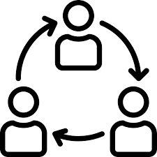
Why is git important?
Documentation Sharing / Collaborating
Git facilitates both!

Slide 3


Why is git important for scientists?
Data collection & experiment
Data processing & analysis
Record parameters and changes in lab notebook (paper/digital)
?
Version control of code = lab notebook of experiment

Slide 5




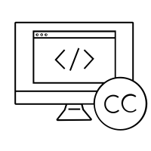
Why is learning git important? Sharing/Collaboration
Sharing codes are difficult through traditional means
GitHub/GitLab enables code sharing, but it uses git
Someone can follow your codes
Incorporate or suggest changes to others (even strangers!)
Encourages open source and open science
Open science is a huge topic
Openness to your code is generally a good idea

Slide 6
What is the goal today?
Git for version control & documentation
GitHub/GitLab for sharing code, issue-tracking, continuous integration, etc.

Slide 7
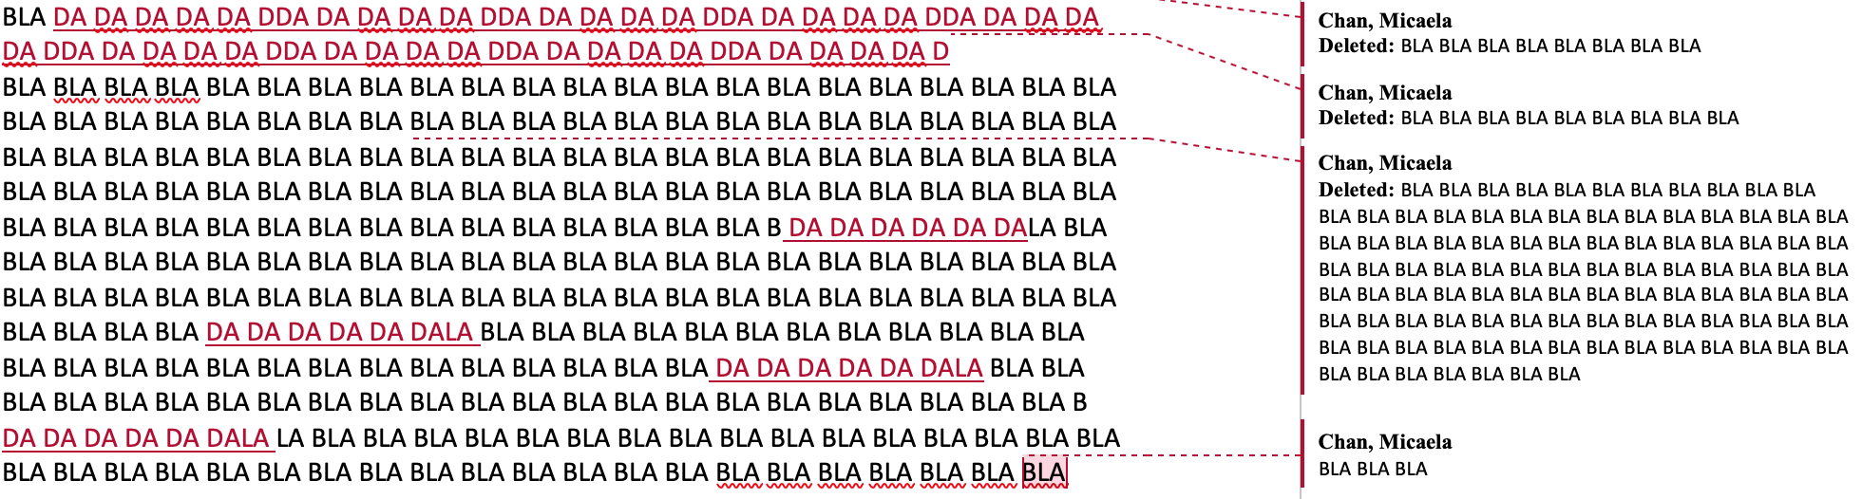
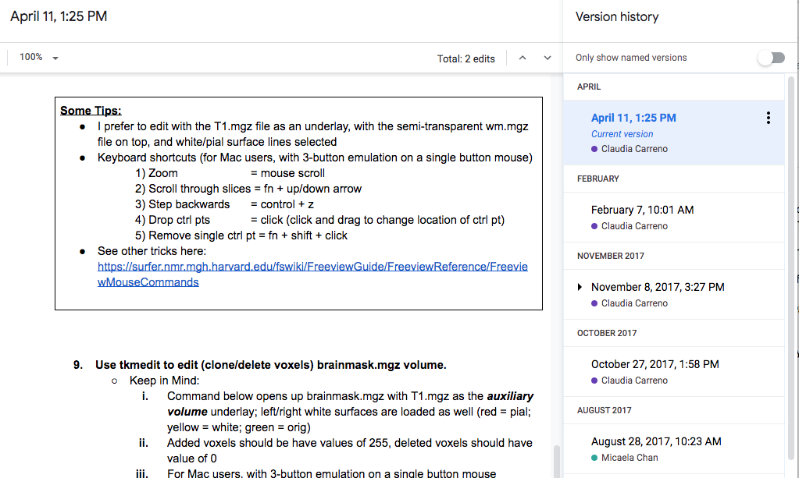
Git Overview What do we do for word documents?
Track Changes (e.g., Microsoft Word)
Highlighted changes
Version History (e.g., Google-doc)
Snapshots
Whale, Shady
Whale, Shady
Whale, Shady
Shady Whale
Git track changes & gives you a version history!

Slide 8
Git Overview What is being tracked?
Don’t think of it as multiple documents, but base document + sets of changes
base document
changes

Slide 9
Git Overview Separate changes can be made, and recorded
Incorporate Change 1
Incorporate Change 2

Slide 10



Hands on portion of the workshop
Dark bubble with text are terminal commands (bash)
Type into a terminal window or Git-Bash
OS icon will be next to the commands specific to an OS
Everything in this presentation is on a bookdown page:
https://gitbookdown.dallasdatascience.com
> echo hello
Windows
Mac
Linux

Slide 11
1. Setting up git 1.1 Download git
Windows users: https://gitforwindows.org/
Git-Bash is a bash terminal that comes with Git for Windows.
In this workshop, we assume Windows User have Git-Bash, so you can use functions such as “echo” or “touch”
Linux/Mac Users: https://git-scm.com
Notes:
Git can also be run from Power Shell, but Git Bash would allow you to run every command in this tutorial (e.g., functions such as touch or echo for making file and printing lines in a terminal).

Slide 12
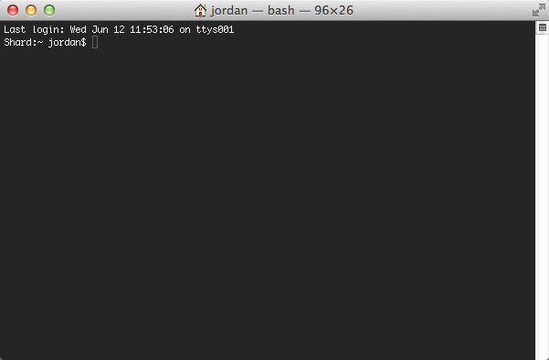
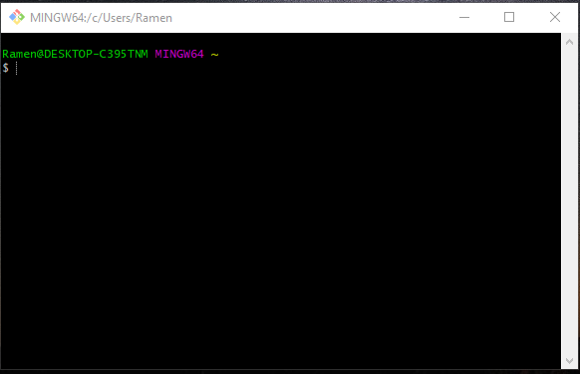
1. Setting up git Open a terminal / Git-Bash

Slide 13
1. Setting up git 1.2 Configure git
Username & email
[OPTIONAL]
If you don’t want to use vim, setup another default text editor
nano is an easy terminal text editor
> git config --global user.name "Shady Whale"
> git config --global user.email "shadywhale@allthewhales.com"
> git config --global core.editor "nano -w"
Now you should have Git installed on your personal computer (or server), with basic configurations all set and ready to go!
Notes:
git config --global core.autocrlf input
git config --global core.autocrlf true (windows)
Atom: "atom --wait”
Sublime (Mac): "subl -n -w”
Sublime (Windows): 'c:/program files (x86)/sublime text 3/sublimetext.exe' -w” (32bit)
Textmate: "mate -w"

Slide 14
2. Creating a repository What is a repository?
Repository (repo):
An index that tracks changes of a directory
a .git/ subdirectory
Directory
Old school drum memory
Notes:
https://en.wikipedia.org/wiki/Drum_memory
Index/database are just collection of data

Slide 15
2. Creating a repository > git init
2.1 – Create a directory in your home directory
2.2 – Create a repository
Check the status of the git repository
> mkdir ~/workdir
> cd ~/workdir
Directory
> git init
> ls -a
> git status
You now have a repository (i.e., a .git/ folder) within a directory that you want to track!

Slide 16
3. Tracking Changes > git add, commit
git add
Tells git which changes you want to track
Formally, this is call adding a file to the “staging area”
git commit
Tell git to document the changes you “added” (i.e., the files in the staging area)
Mandatory commit message that you must provide to explain what changes were made

Slide 17
3. Tracking Changes > git add, commit
3.1 – Adding new files/modification to staging area
Make a new file and check status of git
Let’s tell Git to track the file
> touch foo.txt
> git status
> git add foo.txt
> git status
Notes:
touch is used to create a file in bash

Slide 18
3. Tracking Changes > git add, commit
3.2 – Saving these changes to the repository
Commit the file with a commit message
Let’s check the log, which lists all the commits made so far
> git commit –m “Add foo.txt to repo”
> git log
Notes:
touch is used to create a file in bash

Slide 19
3. Tracking Changes > git add, commit
PRACTICE:
Let’s add a line to the file and git add & commit it!
> echo hello >> foo.txt
> git add foo.txt
> git commit
[in your text editor] Add hello in foo.txt ### [save file and exit editor] > git log
You have now used git add & commit to track a file. Use git log to read what you have done so far in this repository!
Notes:
echo prints a string
>> put the string on its left side into the file on its right side

Slide 20
4. Exploring History > git diff & show
4.1 – Difference between current file and N commit ago
Edit the file and check difference between your current foo.txt and the last commit
What about compared to two commits ago?
> echo world >> foo.txt
> git diff HEAD foo.txt
> git diff HEAD~1 foo.txt
HEAD~1 can be replaced with the specific identifier of a commit. Use git log to check

Slide 21
4. Exploring History > git diff & show
4.2 – What was done in ____ commit?
Sometimes we want to check what was done during a certain commit
**BONUS** If there are multiple branches (e.g., master, feature1), you can git show a different branch
And use the symbol ^ to go to a relative-commit (e.g., master^ means go to the master branch 1 commit ago)
> git show HEAD~1 foo.txt
> git show <branch name> foo.txt
You have now compared different versions of a file using git diff and check changes during a specific commit using git show.

Slide 22
5. Telling git to ignore certain files .gitignore
Sometimes we don’t want git to track a certain type of files
Temporary files/big data/OS files
Adding a file/directory to .gitignore
Try git add a file we added to .gitignore, it won’t let us
> touch ignore_this.txt
> echo ignore_this.txt >> .gitignore
> git add ignore_this.txt
There should now be a .gitignore file in your directory.
Notes:
* .gitignore can ignore an entire subdirectory.
* You can use wildcard expressions in this file as well. Some common things in a .gitignore file are .*, *~, ~*, which are often temporary or backup files.

Slide 23

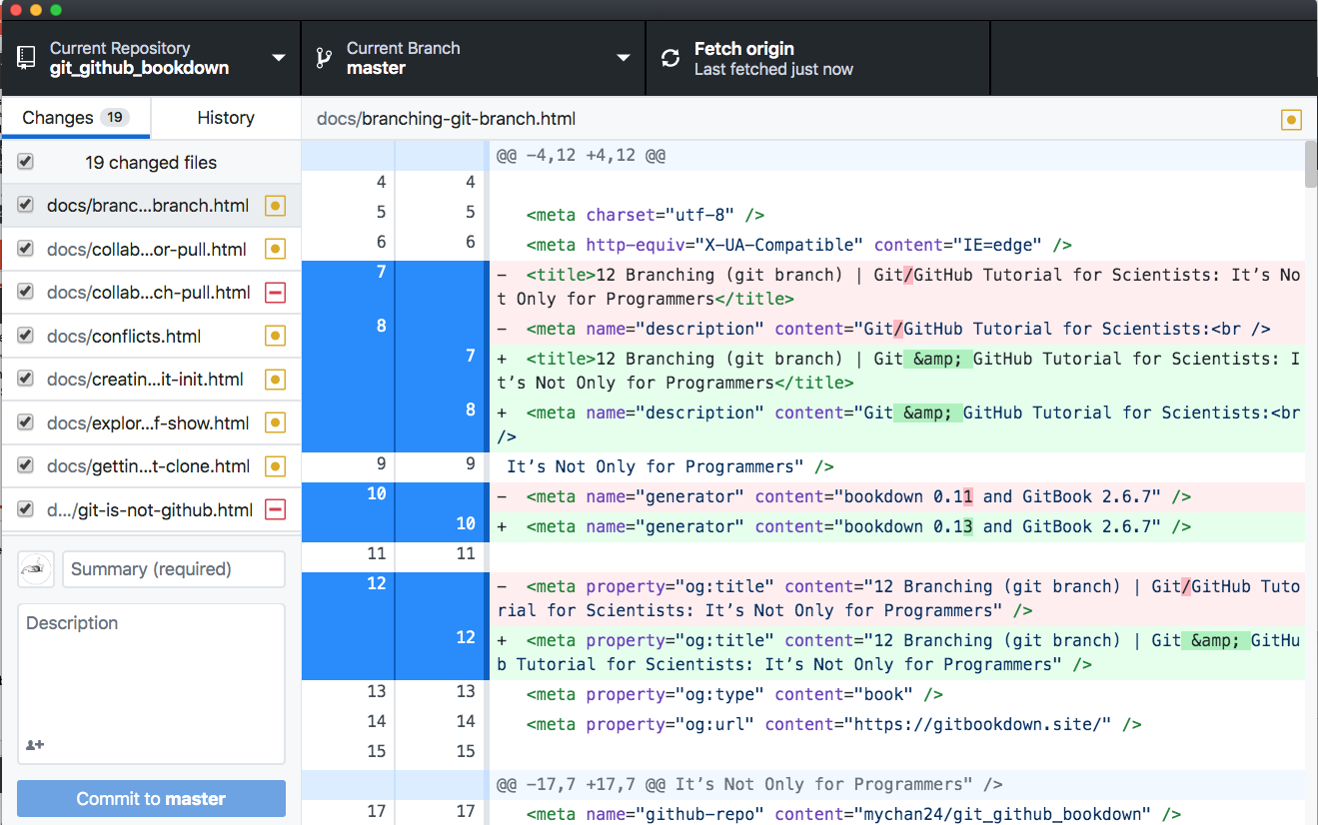


Desktop Application
GitHub Desktop
Sourcetree
GitKraken
Tower

Slide 24
This ends the intro to the version control function of git.
Next up:

Slide 25
BREAK
If you don’t have a GitHub account yet,
please sign-up for an account at https://github.com

Slide 26
Remote Hosts
A remote server that hosts repositories for free/a-fee…
It also offers visualization of code changes and collaboration tools & insights + tons of other features!
Some alternatives
Google Cloud Source Repository

Slide 27
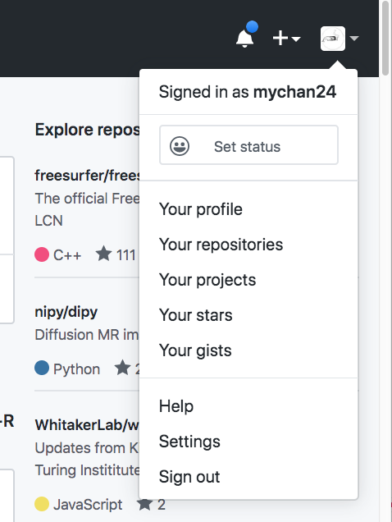
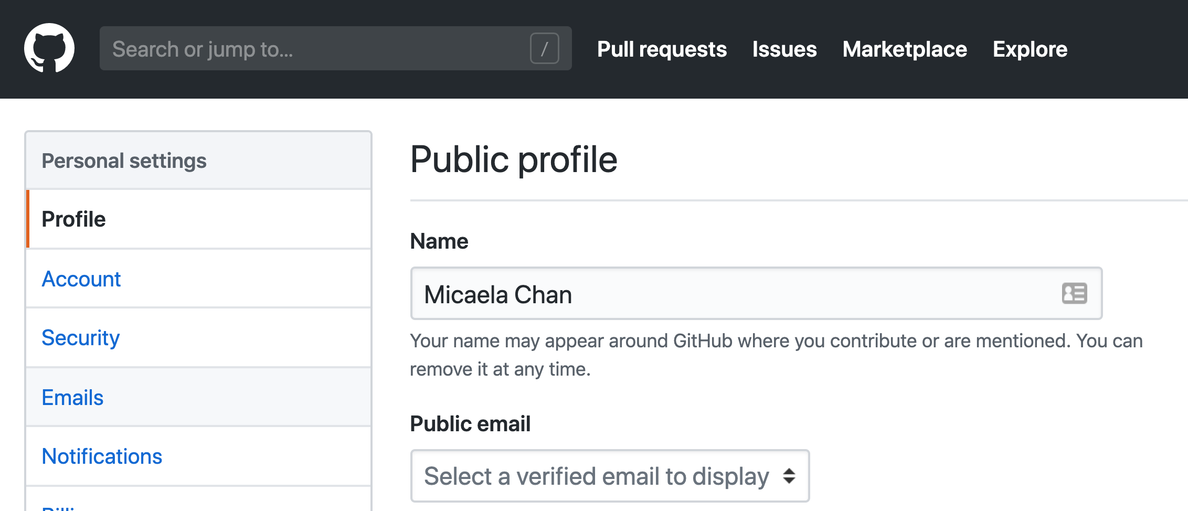
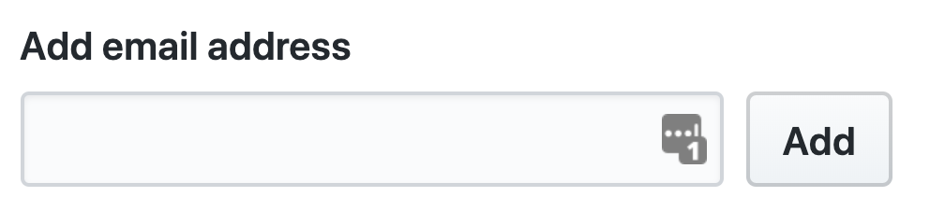
Configure GitHub’s Email Setting
Go to Settings
2) Click Emails
3) Enter email you
used for workdir
4) For this tutorial, un-check ‘Block command’

Slide 28



6. Create a repository on GitLab make a repo
Create a remote repository
Go to https://gitlab.circ.utdallas.edu/
Click the Repositories tab
Click
Enter workdir as the Repository name, click
NOTE: We will skip adding a README
Click to copy the URL of this repository
Use SSH!
You now have an empty remote repository and some instructions to populate it!

Slide 29
Setting up SSH key
1. Generate an SSH key pair
> ssh-keygen -t ed25519
2. Copy the public key’s content
> cat ~/.ssh/id_ed25519.pub | clip
Windows
> pbcopy < id_ed25519.pub
Mac
> xclip -sel clip < ~/.ssh/id_ed25519.pub
Linux
3. Paste in SSH setup on GitLab (https://gitlab.circ.utdallas.edu/profile/keys)

Slide 30

7. Putting codes on GitLab > git remote add & push
git remote add:
Establish ‘connection’ with a remote repository by its url so you can download/upload from it.
git push:
Upload a commit(s) to a remote repository.
Notes:
BONUS - SSH keys
Here is a link to help you setup using SSH keys for authentication with Github https://help.github.com/en/enterprise/2.15/user/articles/adding-a-new-ssh-key-to-your-github-account

Slide 31
7. Putting codes on GitLab > git remote add & push
7.1 – Push an existing repository from your local computer
Go to workdir & add a remote repository that you want to push your data to
Push your local repository to your GitLab
> cd ~/workdir
> git remote add origin <copied URL>
https://gitlab.circ.utdallas.edu/<username>/workdir.git
> git push –u origin master
Your code is now available on GitLab!
Notes:
BONUS - SSH keys
Here is a link to help you setup using SSH keys for authentication with Github https://help.github.com/en/enterprise/2.15/user/articles/adding-a-new-ssh-key-to-your-github-account

Slide 32
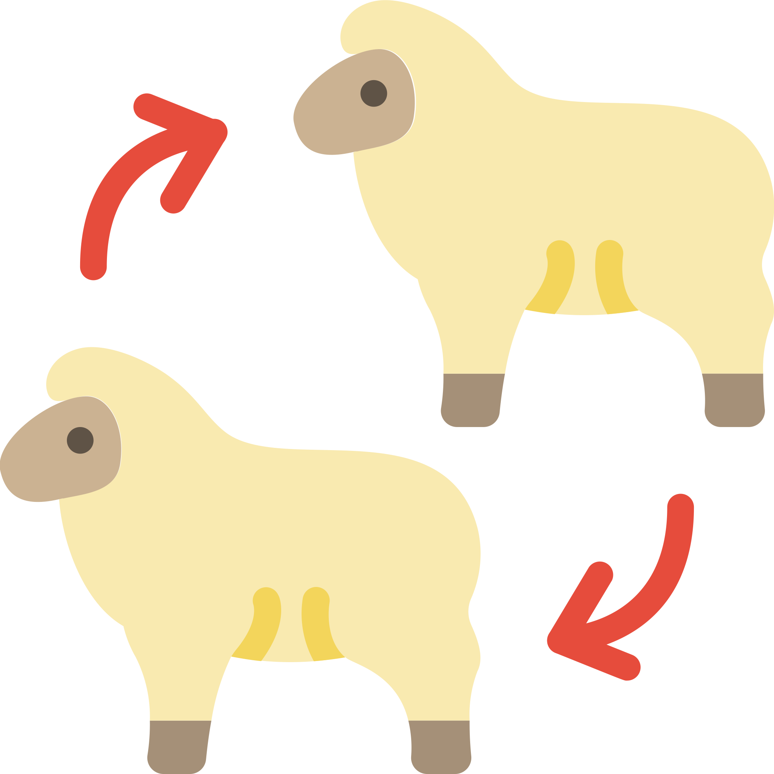

8. Getting a repository from GitLab git clone & fork
Clone
Copy an entire repository
Fork
Copy a GitLab repository into your GitLab
Usually we clone from GitLab to our computer
Its essentially cloning from GitLab to GitLab
Notes:
Icons made by Smashicons from Flaticon
https://www.flaticon.com/authors/smashicons
Dave Gandy
https://www.flaticon.com/authors/dave-gandy
Iconnice
iconnice
www.flaticon.com

Slide 33
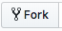
8. Getting a repository from GitLab Practice fork & clone
8.1 – Lets Fork the repository with this presentation
Go to https://gitlab.circ.utdallas.edu/mxc108120/git_workshop
Fork it by clicking
You’ll be redirected to a copy of the same repository in YOUR Gitlab account

Slide 34
8. Getting a repository from GitLab Practice fork & clone
8.2 – Now lets clone that to your computer
Go to https://gitlab.circ.utdallas.edu/<username>/git_workshop
Click to copy the URL for cloning
Clone it using the following command line
> cd ~
> git clone <copied URL>
You have forked & cloned someone else’s repository!

Slide 35
9. Collaborating
9.1 – Setup a fake collaborator (i.e., yourself in another directory)
Go to your GitLab account’s workdir repository:
Copy the URL
Clone it to a new directory call at “~/workdir_fake_collab”
> git clone <copied URL> ~/workdir_fake_collab
https://gitlab.circ.utdallas.edu/ username>/workdir.git

Slide 36
9. Collaborating
Make changes as fake collaborator and push to GitLab
Go into the collab’s directory, make a new file foofoo.txt
Git add & commit foofoo.txt
Push this change to GitLab
> cd ~/workdir_fake_collab
> touch foofoo.txt
> git add foofoo.txt
> git commit -m "Add foofoo.txt"
> git push origin master

Slide 37
9. Collaborating
Where is foofoo.txt?
✓
Foo
Foo
X
✓
workdir
workdir_fake_collab

Slide 38


9. Collaborating > git fetch & merge
Fetch
Download snapshot of remote
Merge
Integrate fetched changes
Downloading the changes into .git
Incorporate changes to local files

Slide 39
9. Collaborating > git fetch & merge
9.2 – Implement the changes in original workdir
Fetch the changes your fake collaborator pushed to GitLab
Check what your collaborator has changed compared to your local version
> cd ~/workdir
> git fetch
> git diff master origin/master
Master branch on GitLab
(origin is what we nicknamed our remote repo on GitLab)
Your local master branch

Slide 40
9. Collaborating > git fetch & merge
If these are changes you want in your workdir, merge the changes
> git merge
✓
✓
✓
workdir
workdir_fake_collab
You have now fetched and merged changes from different people (or yourself on a different computer/folder)!

Slide 41
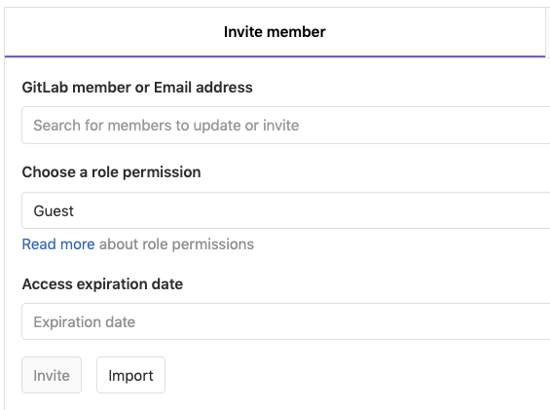

9. Collaborating Collaborators
Add collaborators in your GitLab repository

Slide 42
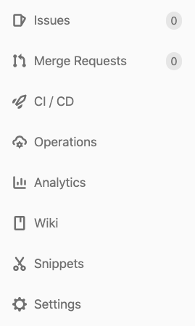
9. Collaborating Other Tools in GitLab (or GitHub)
This is call a ‘pull request’ in Github
Work-flow to use merge request
Add & Commit Changes
Fork one GitLab & clone the repo
Track your changes using Git
Push changes to GitLab
Make a
merge request
The user with the permission to approve it can review your changes before incorporating it

Slide 43
9. Collaborating Other Tools in GitLab (or GitHub)
Track tasks & status
Report bugs/issues
Manage project ideas/implementation
Continuous integration (CI) and continuous delivery (CD)
Automate tasks
e.g., CI can be use to check a merge request and automate merging back into master branch
e.g., CD can be use to automatically deliver/deploy your change
Can be simple or very extensive
It’s a WIKI. Gitlab has one for every project
Formats: Markdown, RDoc, AsciiDoc, and Org

Slide 44
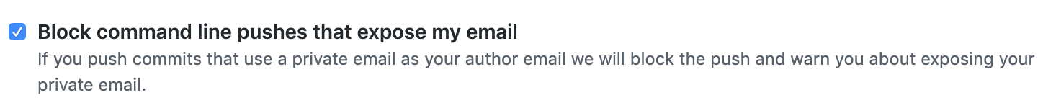
Email settings in real life
If you are going to push into a repository that is public, consider setting up the no-reply email. (e.g., GitHub by default warns you if you are pushing into a public repo with personal email accounts)
Check the following Setting on GitHub
> git config --global user.email ”shadywhale@users.noreply.github.com"

Slide 45
Advanced Git Topics
The following topics are covered using the bookdown
https://gitbookdown.dallasdatascience.com
Resolving conflicts
Reverting to a previous commit (reset vs. revert)
Branching
An interactive branching guide: https://learngitbranching.js.org/
Stashing
Some other topics not covered: rebase, squash (combining commits)

Slide 46
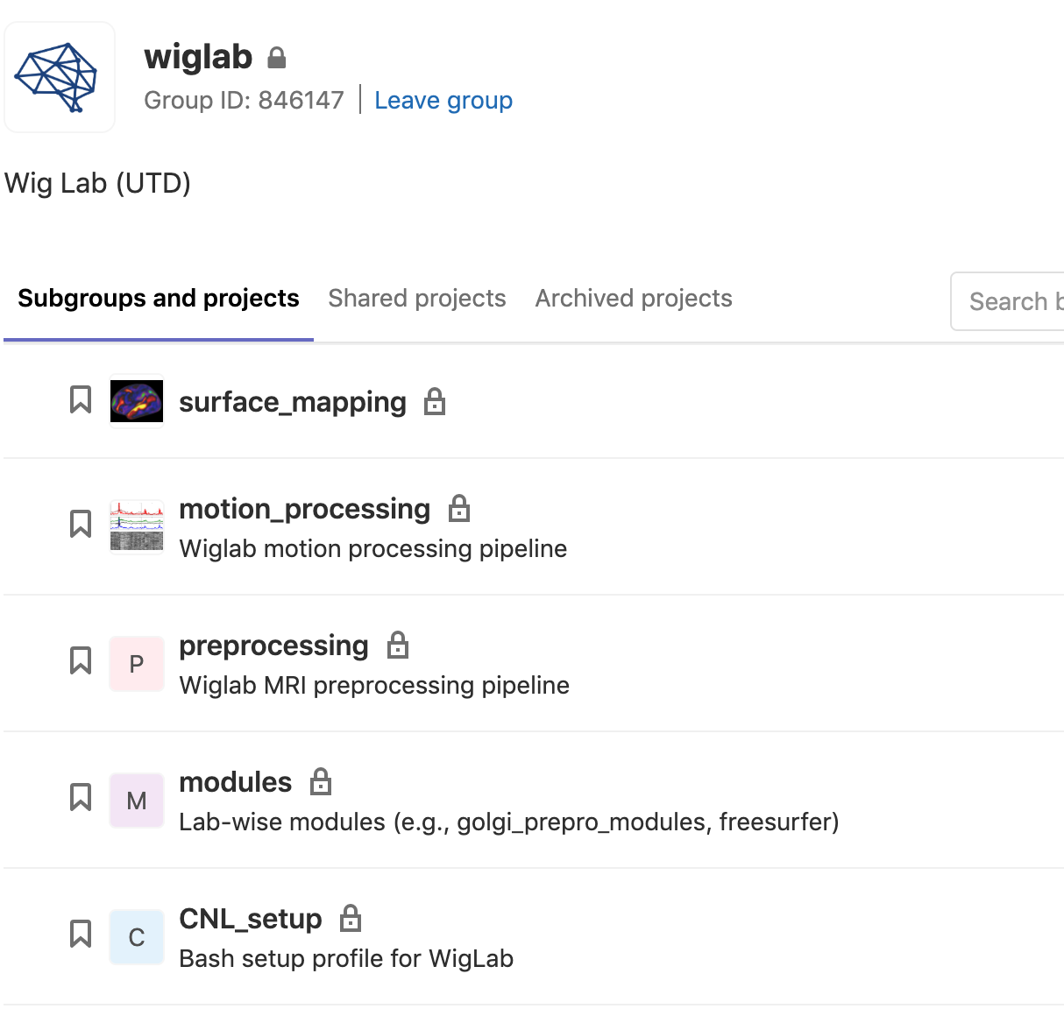
Other resources
GitHub Education Pack
https://education.github.com/
Pro account for students, academic researchers (i.e., postdoc) & faculties
GitLab

Slide 47



Acknowledgement

